Slide 1
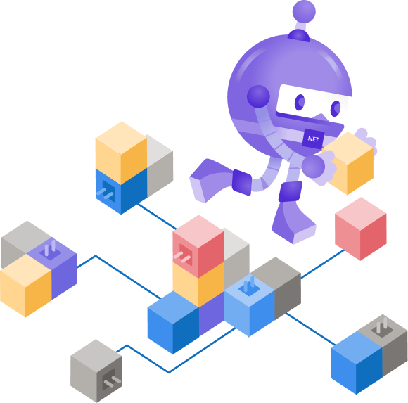
Welcome to .NET Conf: Focus on Microservices
Scott Hunter
Director Program Management, .NET
@coolcsh
David Fowler
Partner Software Architect, .NET
@davidfowl

Slide 2
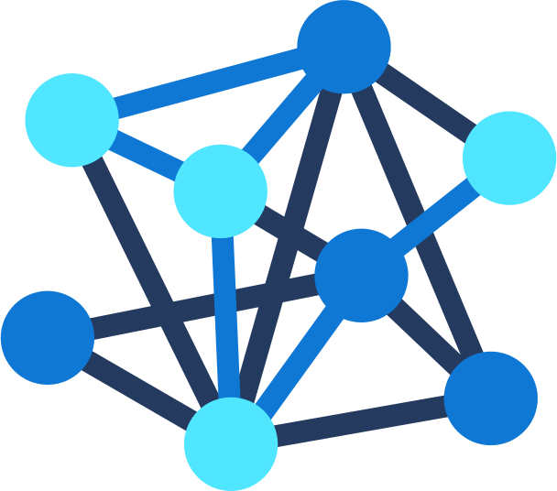

.NET
Your platform for building anything
Desktop
Web
Cloud
Mobile
Gaming
IoT
AI
Notes:
You can build anything with .NET.
.NET is a free, cross-platform, open source developer platform for building many different types of applications. With .NET, you can use multiple languages, editors, and libraries to build for web, mobile, desktop, gaming, and IoT. .NET is designed to be general-purpose so that once a developer learns how to build one type of application, they can quickly build other types of applications for completely different workloads – developer skills can easily transfer to other domains using the same languages and libraries.
.NET enables developers to be more productive building feature-rich applications of any type, for any device with great performance.

Slide 3




.NET ecosystem momentum
>1.5M .NET Core developers
#1 Most Loved
Framework (2019 & 2020)
Top 30
Highest velocity OSS projects
.NET Core
github.com/dotnet github.com/aspnet
in Visual Studio
Top 5
Language on GitHub
7x
Faster than Node.js
40%
New to .NET are students
C#
ASP.NET Core
dot.net download survey
insights.stackoverflow.com/survey/2019#most-loved-dreaded-and-wanted & insights.stackoverflow.com/survey/2020#most-loved-dreaded-and-wanted
github.com/cncf/velocity/
octoverse.github.com/
www.techempower.com/benchmarks/#section=data-r18&hw=ph&test=plaintext
Notes:
We are seeing significant growth….
Talk to data points above
-----
Additional data points –
-C# moved from 7th to 5th in TIOBE Language Index 2020
-.NET Core 3 is fastest adopted version of .NET, ever
-dotnet org on GitHub has been top 3 highest velocity projects three years in a row as named by CNCF (see slide 13 for details)
Sources:
https://insights.stackoverflow.com/survey/2019#most-loved-dreaded-and-wanted
https://github.com/cncf/velocity/
https://octoverse.github.com/
https://www.techempower.com/benchmarks/#section=data-r18&hw=ph&test=plaintext

Slide 4
.NET adoption
5 million .NET devs
Visual Studio
+1 million new
Monthly active developers in Visual Studio Family
Monthly active .NET developers in the last year
.NET Core
+600K new
Monthly active .NET Core developers in the last year
.NET on Linux
2 million
Publishes to Linux from Visual Studio
Notes:
And our user base keeps growing!
There are over 5 million active .NET developers in Visual Studio Family (VS, VSCode, VS4Mac). We’ve seen significant growth with .NET Core, our open source, cross-platform .NET, now has surpassed 1.5 million active developers per month and we’ve seen over 600 thousand new developers in the last year.
We’re also now seeing over 1 million deployments to Linux from Visual Studio.
<CLICK>

Slide 5

.NET Core 3
Fastest adopted version of .NET, ever.
dot.net/get-core3
Notes:
Within 6 weeks of .NET Core 3 shipping, 75% of our users had tried it.
It’s now the most used version of any .NET Core versions.

Slide 6
.NET 5 performance improvements
+30% socket performance improvement on Linux over .NET Core 3.1
JSON serialization performance improved +19% over .NET Core 3.1¹
Serialization for large collections and arrays improved 3x and are now zero-alloc
.NET gRPC perf equals or exceeds Go. .NET Client is 3x faster under heavy load²
¹All 104 JSON serialization benchmarks improved
²Heavy load is 70 concurrent requests x 28 connections
Notes:
We continue our investments in performance.
RPS = 70 concurrent requests
Heavy Load = 70 concurrent requests x 28 connections

Slide 7


RELEASED
PREVIEW
.NET Core 3.1 LTS
.NET 5 Preview 7
Use it today!
Try it and give feedback
dot.net/get-core3
dot.net/get-dotnet5
Notes:
Build apps with .NET Core 3.1 LTS today and try out the .NET 5 preview and give us feedback.

Slide 8
.NET Schedule
Dec 2019
.NET Core 3.1
LTS
Nov 2020
.NET 5.0
Nov 2021
.NET 6.0
LTS
Nov 2022
.NET 7.0
Nov 2023
.NET 8.0
LTS
.NET 5.0 release in November 2020
Major releases every year
LTS for even numbered releases
Predictable schedule, minor releases as needed
Notes:
Predictable releases helps everyone, not only the businesses that use .NET but also the open source projects that are built upon .NET.

Slide 9

SAVE THE DATE
.NET Conf 2020
November 10 – 12
.NET 5 launch
Free, three-day, virtual event
Call for content opens tomorrow!
www.dotnetconf.net
Notes:
I’m excited to announce that .NET Conf 2020 will be November 10-12 where we will launch .NET 5. Save the date!

Slide 10
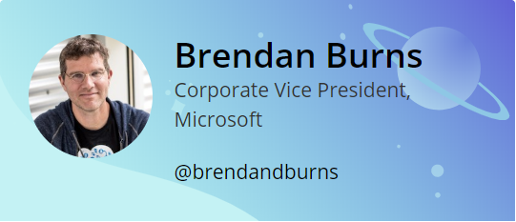
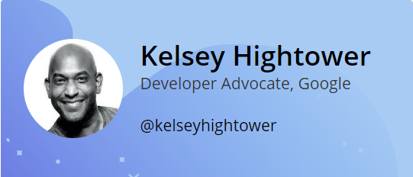
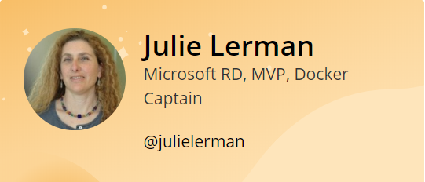
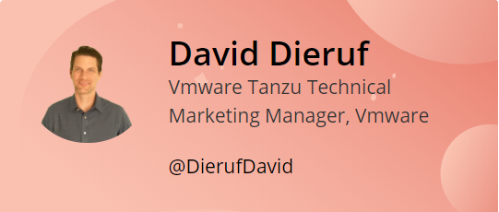
Agenda and special guests
Today –> Full day of sessions from industry experts
Brendan Burns – Why you should care about microservices
Kelsey Hightower – “Stay Sharp”
David Dieruf – .NET microservices with Steeltoe
Julie Lerman, Jessica Deen, & many more fantastic speakers!
Tune in tomorrow, 9AM PT – 3PM PT –> Workshop
Architecting Microservices in .NET and Azure
6-hrs of deep dive content
Interactive sessions on twitch.tv/VisualStudio
Notes:
I’m really excited about out lineup today. We have some fantastic industry speakers for you ….
Why You Should Care About Microservices - Brendan Burns 09:00 (PT) | 17:00 (UTC)
Stay Sharp - Kelsey Hightower 10:00 (PT) | 18:00 (UTC)
A Journey into .NET Microservices with Steeltoe - David Dieruf 11:00 (PT) | 19:00 (UTC)
Orleans at Microsoft - Reuben Bond 11:30 (PT) | 19:30 (UTC)
Adding a Little DAPR to Your .NET Microservices - Cecil Philip 12:00 (PT) | 20:00 (UTC)
Developing and Deploying Microservices with 'Tye' - Glenn Condron Justin Kotalik 12:30 (PT) | 20:30 (UTC)
Beyond REST and RPC: Asynchronous Eventing and Messaging Patterns - Clemens Vasters 13:00 (PT) | 21:00 (UTC)
The Intersection of Microservices, Domain-Driven Design and Entity Framework Core - Julie Lerman 13:30 (PT) | 21:30 (UTC)
Build High-performance Microservices with gRPC and .NET - James Newton-King 14:00 (PT) | 22:00 (UTC)
DevOps, Waffles, and Superheroes - Oh My! - Jessica Deen 14:30 (PT) | 22:30 (UTC)
API Communication in Microservices with Azure API Management and Azure Functions - LaBrina Loving 15:00 (PT) | 23:00 (UTC)
Evolving .NET Framework Monoliths with .NET 5 and Kubernetes - Elton Stoneman 15:30 (PT) | 23:30 (UTC)
Migrating .NET Framework Web Apps to Azure - Carey Payette 16:00 (PT) | 00:00 (UTC)
Building & Debugging Microservices faster using Kubernetes and Visual Studio - Shayne Boyer 16:30 (PT) | 00:30 (UTC)

Slide 11
What are microservices?

Slide 12
Microservices: for faster app development
Monolithic
Microservices
Large, all-inclusive app
Small, independent services
Independent deployments
Improved scale and resource utilization per service
Smaller, focused teams
App
App
App
Notes:
The move to containers and the cloud makes us re-think our software architecture. The industry has embraced an architectural pattern for building cloud-scale, reliable services.
Microservices are Independent, immutable deployments within containers
Small scalable services for improved resource utilization
Teams can focus on their own service without affecting other, use their own tools/stack
Microservices - also known as the microservice architecture - is an architectural style that structures an application as a collection of services that are
- Highly maintainable and testable
- Loosely coupled
- Independently deployable
- Organized around business capabilities
- Owned by a small team
.NET Core was built for the cloud and is well suited for this type of development. Today we’re going to show you a lot of investments we’re making to help you build microservices.

Slide 13
What is a container?
Containers
Containers
VM
VM
App1
App2
App1
App1
Binaries & libraries
Binaries & libraries
Binaries & libraries
Binaries & libraries
Guest OS
Guest OS
Virtual machines
Containers
Virtualize the hardware
Virtualize the operating system
VMs as units of scaling
Applications as units of scaling

Slide 14
Traditional virtualized environment
From dev to production, you have agility across development and operations teams
Virtual machine
Virtual machine
Low utilization of resources
App
App
Hypervisor
Host OS
Hardware
Notes:
Virtualized environments provide the agility you need to spin up environments quickly however there are often low utilization of resources.

Slide 15
Advantages of a containerized environment
Containerize applications and their dependencies for portability
Migrate containers and their dependencies to underutilized VMs for improved density and isolation
Virtual machine
Virtual machine
Decommission unused resources for efficiency gains and cost savings
Container
Container
Container
Container
App
Hypervisor
Docker Engine
Host OS
Hardware
Notes:
Since containers are lighter-weight, they can be scaled easily. You can move containers to underutilized VMs for improved density and cost savings.

Slide 16
By 2022
75
>
%
of global organizations will be running containerized applications in production¹
¹Gartner.
Notes:
Full statistic sources
Gartner. “6 Best Practices for Creating a Container Platform Strategy.” April 23, 2019. https://www.gartner.com/smarterwithgartner/6-best-practices-for-creating-a-container-platform-strategy/

Slide 17
What’s behind the growth?
Kubernetes: the leading orchestrator shaping the future app development and management
It’s widely used
It’s vendor-neutral
It’s community-supported
Kubernetes is in production for global companies across industries¹
A variety of cloud providers offer robust Kubernetes support
There’s a huge community of active contributors supporting Kubernetes²
Capital One
eBay
SAP
Azure
AWS
35,000 contributors since 2016
1.1 million contributions since 2016
New York Times
Pokémon Go
Spotify
VMWare
Red Hat
¹Kubernetes.io. “Kubernetes User Case Studies.” ²CNCF. K8s Project Journey
Notes:
Full statistic sources
Kubernetes.io. “Kubernetes User Case Studies.” https://kubernetes.io/case-studies/
CNCF. Kubernetes Project Journey, https://www.cncf.io/cncf-kubernetes-project-journey/
CNCF. “Kubernetes Is First CNCF Project To Graduate.” March 6, 2018. https://www.cncf.io/blog/2018/03/06/kubernetes-first-cncf-project-graduate/

Slide 18
How Kubernetes works
Kubernetes control
Worker node
kubelet
kube-proxy
Internet
Kubernetes users communicate with API server and apply desired state
Master node
Docker
Pod
Pod
Master nodes actively enforce desired state on worker nodes
API server
Containers
Containers
Worker nodes support communication between containers
-controller-manager
-scheduler
Worker node
kubelet
kube-proxy
Internet
Worker nodes support communication from the Internet
replication, namespace, serviceaccounts, etc.
etcd
Docker
Pod
Pod
Containers
Containers

Slide 19
.NET investments
for building better containerized apps and microservices…

Slide 20
Cloud native investments
REST API’s
Open API, API REPL, client generation, publish to APIM
gRPC contract-based API’s
Generate client & server from proto file, world class performance
Faster cross-platform development with WSL and Linux
Smaller microservices, single file EXE, top-level C# programs
High-performance reverse proxy (YARP)
Opinionated .NET microservices & orchestration tools (Tye)

Slide 21

Project Tye
AKS
AKS
Build, debug and deploy microservices faster
Service discovery via configuration conventions
Service
Dependency
Add dependencies (Redis, SQL Server, etc.) without writing docker files
Name | Type | Source | Bindings
Frontend
Service
Dependency
Run and debug locally using containers and Kubernetes
Service
Dependency
Local dashboard for metrics, logging, debugging
Automatically dockerize and deploy to Azure Kubernetes Service
Notes:
Project Tye is all about making it easier and faster to build, debug, and deploy microservices.
Service discovery via configuration conventions
Runs multiple projects at the same time
Automatically handles connections to each other (ports/URLs)
Add dependencies (Redis, etc.) without writing docker files
Run & debug locally using containers and Kubernetes
Local dashboard for logs, metrics, etc.
Can dockerize and deploy your services to AKS

Slide 22
Demos!
Scott & David

Slide 23


WeatherService Architecture
BlazorServer
Weather
WeatherService
Websockets
gRPC
HTTP
Browser
Climate Control

Slide 24
Recap
.NET has awesome performance and is great for microservices
REST and gRPC API’s with productive tools & debugging
Single-file EXEs make microservices smaller & use less memory
Tye helps you build, debug and deploy microservices quickly
Top-level C# programs enable writing API’s with minimal code

Slide 25
Enjoy the conference!
SAVE THE DATE
.NET Conf 2020 November 10 – 12
Call for content opens tomorrow!
www.dotnetconf.net
Why You Should Care About Microservices - Brendan Burns 09:00 (PT) | 16:00 (UTC)
Stay Sharp - Kelsey Hightower 10:00 (PT) | 17:00 (UTC)
A Journey into .NET Microservices with Steeltoe - David Dieruf 11:00 (PT) | 18:00 (UTC)
Orleans at Microsoft - Reuben Bond 11:30 (PT) | 18:30 (UTC)
Adding a Little DAPR to Your .NET Microservices - Cecil Philip 12:00 (PT) | 19:00 (UTC)
Developing and Deploying Microservices with 'Tye' - Glenn Condron Justin Kotalik 12:30 (PT) | 19:30 (UTC)
Beyond REST and RPC: Asynchronous Eventing and Messaging Patterns - Clemens Vasters 13:00 (PT) | 20:00 (UTC)
The Intersection of Microservices, Domain-Driven Design and Entity Framework Core - Julie Lerman 13:30 (PT) | 20:30 (UTC)
Build High-performance Microservices with gRPC and .NET - James Newton-King 14:00 (PT) | 21:00 (UTC)
DevOps, Waffles, and Superheroes - Oh My! - Jessica Deen 14:30 (PT) | 21:30 (UTC)
API Communication in Microservices with Azure API Management and Azure Functions - LaBrina Loving 15:00 (PT) | 22:00 (UTC)
Evolving .NET Framework Monoliths with .NET 5 and Kubernetes - Elton Stoneman 15:30 (PT) | 22:30 (UTC)
Migrating .NET Framework Web Apps to Azure - Carey Payette 16:00 (PT) | 23:00 (UTC)
Building & Debugging Microservices faster using Kubernetes and Visual Studio - Shayne Boyer 16:30 (PT) | 23:30 (UTC)

Slide 26

Thanks for joining! Ask questions on Twitter: #dotNETConf

